Slide 1
Sorting Algorithms
Data Structures Lab-10

Slide 2
Today’s Content
What is Insertion Sort?
What is Bubble Sort?
What is Selection Sort?
What is Counting Sort?

Slide 3
Insertion Sort?

Slide 4
Insertion Sort

Slide 5
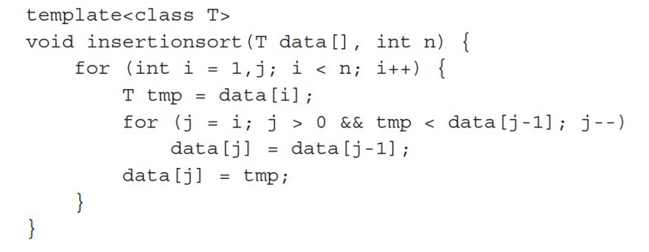
Insertion Sort
O(N²)

Slide 6
Bubble Sort?

Slide 7
Bubble Sort

Slide 8
Bubble Sort
void BubbleSort(T arr[], int n) {
for(int i=0;i<n-1;++i){
for(int j=0;j<n-i-1;++j){
if(arr[j]>arr[j+1]){
T temp = arr[j+1];
arr[j+1] = arr[j];
arr[j] = temp;
}
}
}
}
O(N²)

Slide 9
Selection Sort

Slide 10
Selection Sort

Slide 11
Selection Sort
void selectionSort(int[] list, int listLength) {
int index;
int smallestIndex;
int minIndex;
int temp;
for (index = 0; index < listLength – 1; index++) {
smallestIndex = index;
for (minIndex = index + 1;minIndex < listLength; minIndex++){
if (list[minIndex] < list[smallestIndex]){
smallestIndex = minIndex;
}
}
temp = list[smallestIndex];
list[smallestIndex] = list[index];
list[index] = temp;
}
}
O(N²)

Slide 12
Quick Sort

Slide 13
Quick Sort

Slide 14
Quick Sort
int Partition(int arr[], int s, int e){
int pivot = arr[e];
int pIndex = s;
for(int i = s;i<e;i++){
if(arr[i]<pivot){
int temp = arr[i];
arr[i] = arr[pIndex];
arr[pIndex] = temp;
pIndex++;
}
}
int temp = arr[e];
arr[e] = arr[pIndex];
arr[pIndex] = temp;
return pIndex;
}
void QuickSort(int arr[], int s, int e){
if(s<e){
int p = Partition(arr,s, e);
QuickSort(arr, s, (p-1)); // recursive QS call for left partition
QuickSort(arr, (p+1), e); // recursive QS call for right partition
}
}
O(n log(n)

Slide 15
Counting Sort

Slide 16
Counting Sort

Slide 17
void countSort(int array[], int size) {
int output[10];
int count[10];
int max = array[0];
// Find the largest element of the array
for (int i = 1; i < size; i++) {
if (array[i] > max)
max = array[i];
}
// Initialize count array with all zeros.
for (int i = 0; i <= max; ++i) {
count[i] = 0;
}
// Store the count of each element
for (int i = 0; i < size; i++) {
count[array[i]]++;
}
// Store the cummulative count of each array
for (int i = 1; i <= max; i++) {
count[i] += count[i - 1];
}
// Find the index of each element of the original array in count array, and
// place the elements in output array
for (int i = size - 1; i >= 0; i--) {
output[count[array[i]] - 1] = array[i];
count[array[i]]--;
}
// Copy the sorted elements into original array
for (int i = 0; i < size; i++) {
array[i] = output[i];
}
}
Counting Sort
O(n)

Slide 18
Lab Task

Slide 19
Lab Task
Use Counting and selection sorts to sort the input arrays in a descending order.
TEST CASE:
Input case
[1,2,3,4,5,6,7,8,9]
Output Case
[9,8,7,6,5,4,3,2,1]
Submit ONLY ID.cpp file, other IS NOT ACCEPTED

Slide 20
Thank you!

